Slide 1
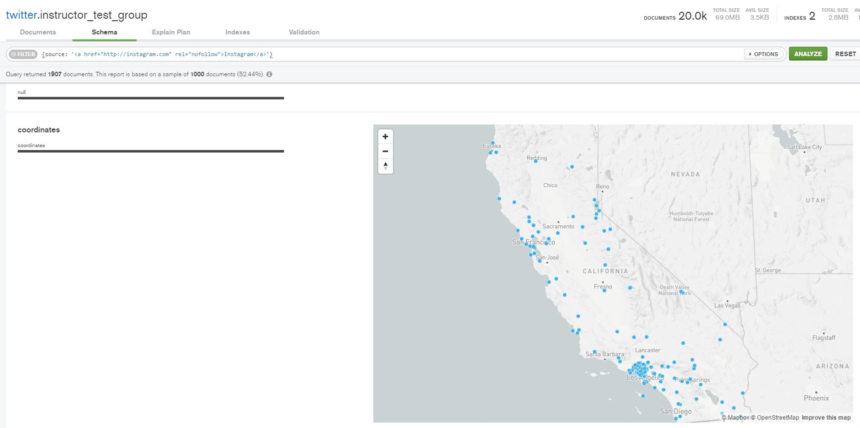
Using MongoDB Compass to Create A Tweet Map
Nicolaus Neiman
Asutosh Rath
Steven Slezak
35882: Hadoop and Managing Big Data
17 Feb 2018

Slide 2
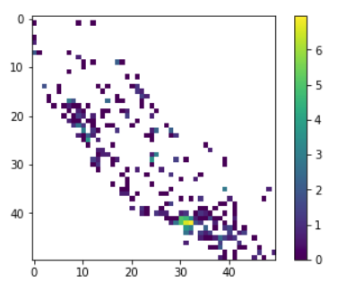

Slide 3


Slide 4
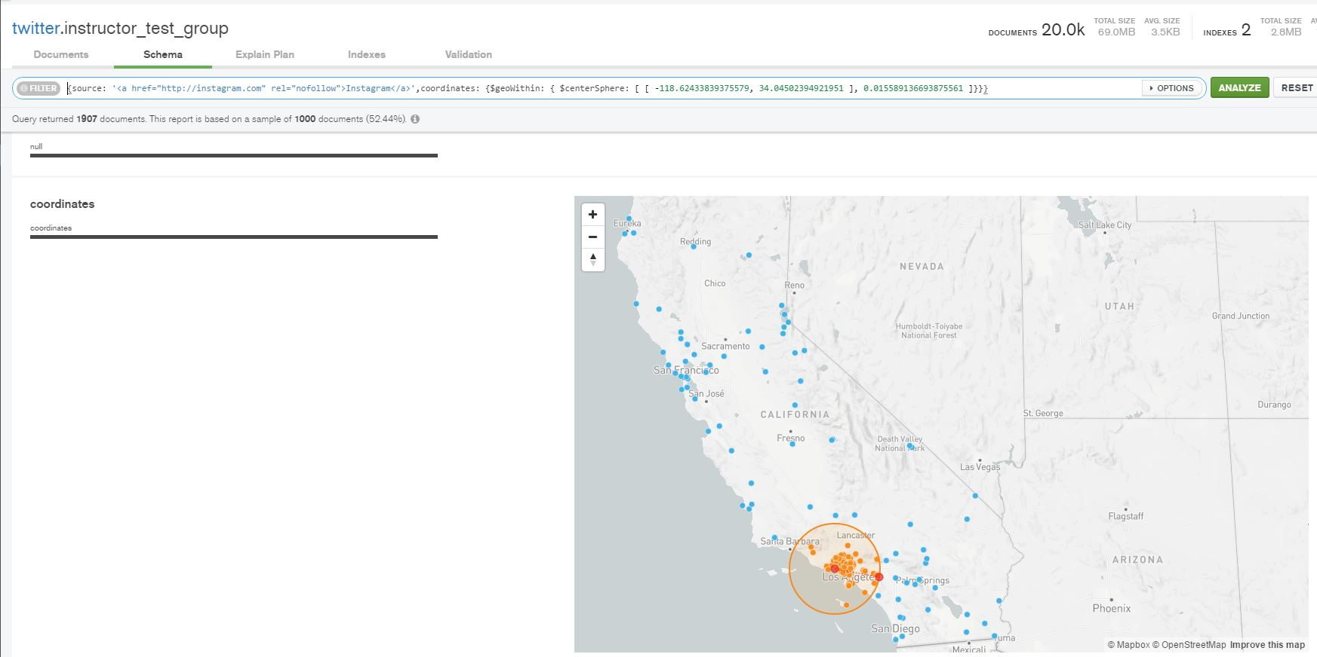

Slide 5
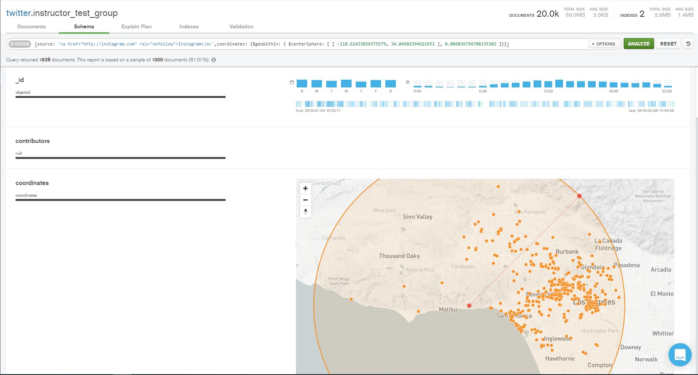

Slide 6
Just Follow These Step-by-Step Instructions
Load MongoDB Compass and Sign On
Click on the twitter Database
Click on instructor_test_group
Notice the Query Bar at the Top of the Page
Click on Schema then Choose Analyze Schema
Scroll Down to source then hover over the bar that says “Instagram”
Click that Bar Turning it Orange
The Query Bar Now Contains Your Query for Searching
this is called a “Graphical Query”

Slide 7
Simple Instructions Continued…
Hit “Analyze”
Hover Over the Map
Shift + Drag to Build Query
this lets you drill down
Create a Circle Around the Area of Interest
Hit “Analyze”
The Data for Your Geographic Area are Displayed
Manipulate the Target with the Red Handle and Hit “Analyze” to Change Your Focus

